Slide 1



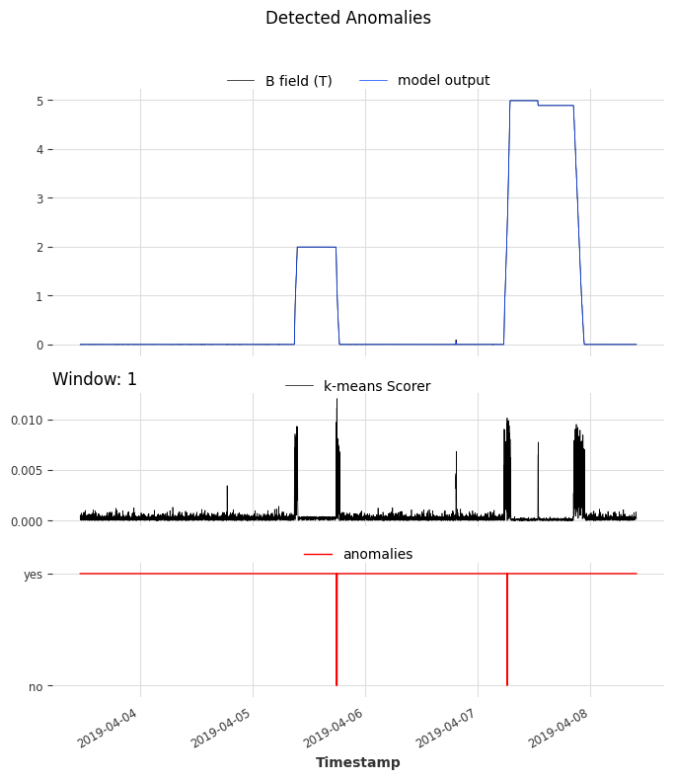
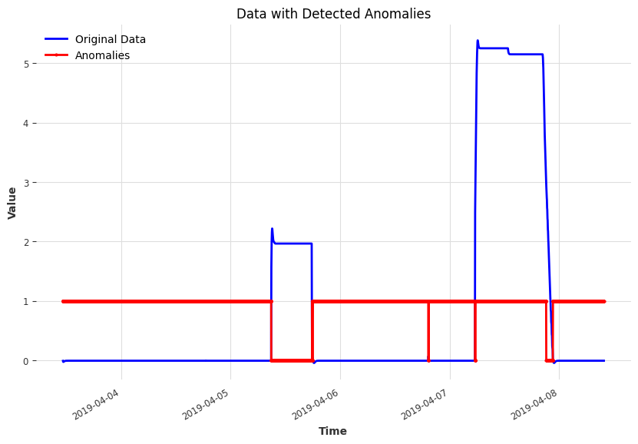
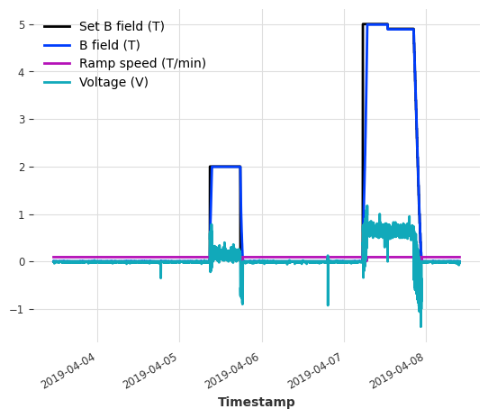
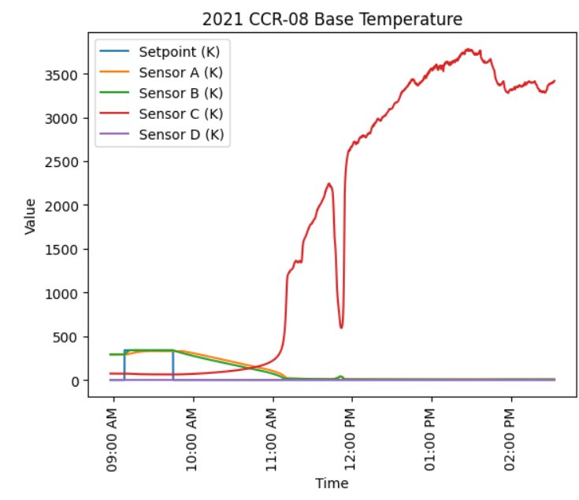
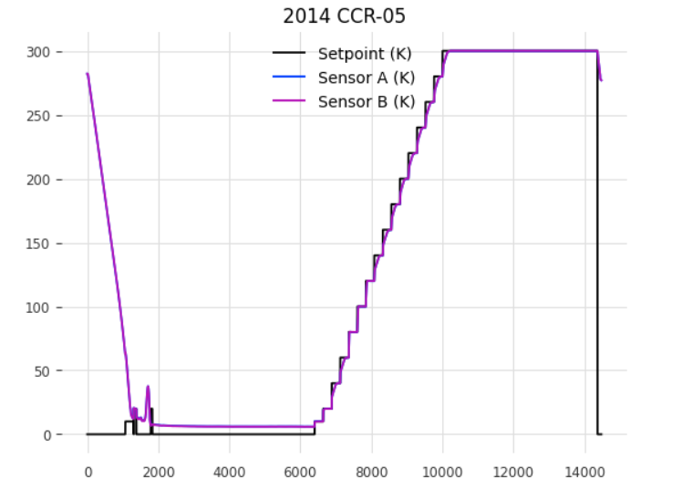
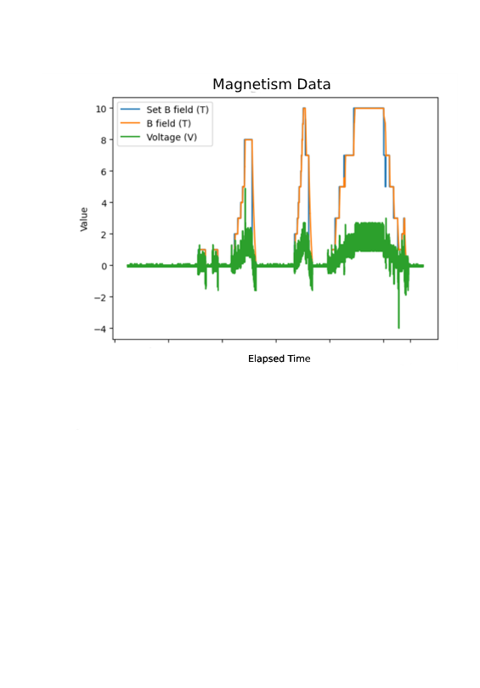
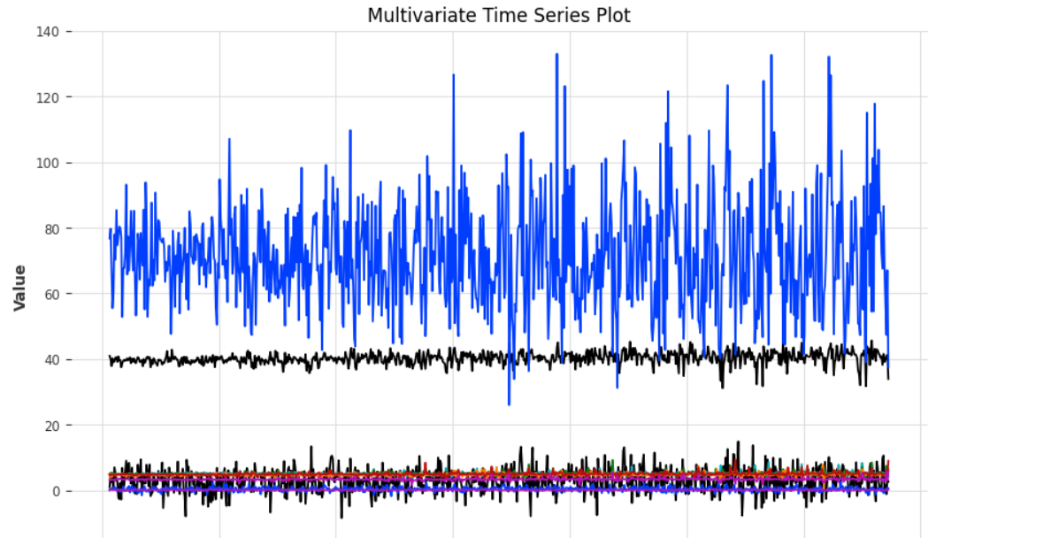
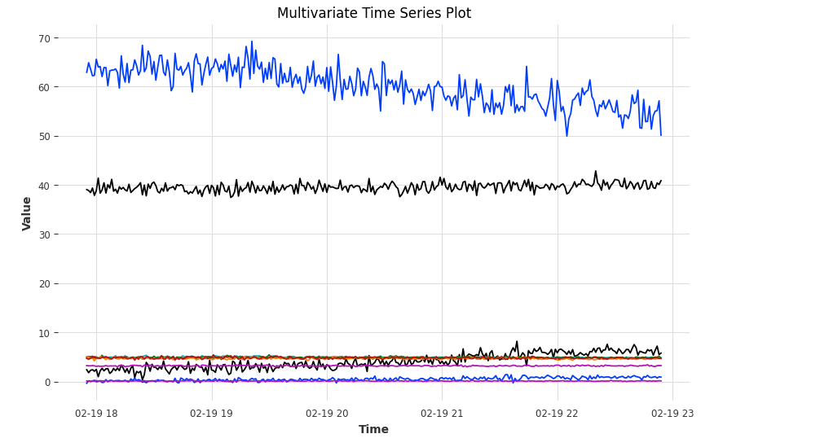
Utilizing Machine Learning for Anomaly Detection
Ryan Park
Thomas Jefferson High School for Science and Technology Computer Systems Lab, 2023-2024
ABSTRACT
SYSTEM SUMMARY
RESULTS
This research addresses the challenge of manual anomaly detection within the National Institute Standards for Technology (NIST) Center for Neutron Research, focusing on the gas compression-based closed-cycle refrigerator (CCR). Currently, temperature control issues are identified through manual troubleshooting. It is crucial to transition from manual to automated data analysis systems due to the constraints surrounding neutron beam experiments. Researchers must reserve beamtime, the allocated time for these facilities, years in advance. These experiments typically last about one week, leaving little tolerance for errors or interruptions. CCR malfunctions in the current manual processes may limit the effective utilization of the scarce beamtime available, resulting in an inefficient use of taxpayer funding for these resources. We propose an automated data analysis system that utilizes a neural network to automatically learn patterns in equipment monitors and detect unusual measurements. Specifically, we aim to implement a transformer model to construct behavior models for control parameters and sensor channels, facilitating continuous monitoring and comparison of predicted sequences with observed data. The goal is to establish comprehensive tracking and prediction capabilities for all aspects of the experiment, consolidated within an integrated beamline status dashboard and text-alert system. This research conducts preliminary investigations into the capabilities of a transformer model to recognize common signal patterns for CCRs. Additionally, this research encom- passes the massaging of data into a standardized format suitable for integration with diverse anomaly detection systems. Future work will integrate additional signal and control monitoring so that users of the NCNR can swiftly detect errors, enabling them to take immediate action and significantly reduce the unnecessary consumption of valuable beamtime.
Live Data Stream
Kalman Filter
Anomaly Scorer
RNN Forecast Model
Threshold Detector
N Time Forecast
Filtering Anomaly Model
Forecast Anomaly Scorer
Fig. 6 Initial Testing with Only Threshold Detector and No Scorer
System Summary
This serves as the system summary for the anomaly detection algorithm. As outlined earlier, the pipeline commences with the direct input from the CCR, which then undergoes processing via the RNN Forecast model. This model generates a time forecast covering the remaining duration of the experiment, denoted as "N" timestamps. Concurrently, the Kalman Filter and Anomaly Scorer modules are initialized. The Anomaly Scorer comprises the K-Means Scorer and Wasserstein Scorer components. The Filtering Anomaly Model is then trained using these inputs to discern normal behavior. Finally, in conjunction with the Threshold Detector, the Forecast Anomaly Scorer is tasked with pinpointing and labeling the precise timestamps identified as anomalous data.
Fig. 5 Anomaly Scorers with Forecast Anomaly Scorer
Fig. 7 Final RNN Forecast Model
Figure 5 presents the conclusive outcomes of the pipeline. The initial step involves variable forecasting, exemplified by the B-field depiction in the upper graph. This output reflects the anticipated behavior generated by the RNN Forecasting Model. The subsequent graph illustrates the K-Means score at each timestamp, showcasing its high sensitivity to abrupt data changes, which aligns with expectations, given the CCR's altered set point. Lastly, the lower graph portrays the precise detection of anomalies at distinct timestamps. In Figure 6, the model's preliminary testing is demonstrated, featuring solely a threshold detector; any values surpassing or falling below a specified threshold are categorized as anomalies. Figure 7 showcases the finalized RNN forecast model, effectively capturing the noise and non-linearity inherent in the CCR's parameters.
INTRODUCTION
METHODS
An anomaly signifies unexpected behavior, often categorized as contextual outliers or collective outliers. Contextual outliers occur within specific contexts, often appearing as jump discontinuities, while collective outliers involve a collection of data points deviating significantly from the norm, such as the contraction of a sine function's period over time. Contextual outliers are able to be identified by the use of a threshold detector, a system that annotates any time stamps above or below a predefined threshold as an anomaly. On the other hand, collective outliers require the analysis of the past patterns and characteristics of the function in order to identify anomalous instances. Within the NIST Center for Neutron Research (NCNR), the CCR plays a pivotal role in experiments with neutron beams under extreme conditions, cooling samples to 4.5 K using helium gas. Despite the critical nature of these experiments, the NCNR lacks an automated system for pinpointing anomalies, resulting in manual troubleshooting and inefficiencies. An exemplary anomaly, such as Sensor C's erratic behavior around 11:30 PM in Figure 1, highlights this need. Moreover, my summer internship revealed the limitations of Transformer Models for time series forecasting, given their complexity, long run times, and susceptibility to noise, as evidenced in Figure 2.
The data utilized for the Anomaly Detection model origin- ates from two primary datasets obtained through the Sample Environment Group, a vital resource assisting re- searchers throughout all phases of neutron beam experiments. These datasets comprise CCR data spanning a 20-year period, capturing both normal and anomalous instances, as well as a Magnetism dataset containing exclusively normal CCR data over the past 23 years. Each experiment's control sequence within these datasets is inherently unique. Preprocessing involved several steps, including upsampling the data to 1 second intervals, applying the Savitzky-Golay Filter for smoothing, and performing a 60/40 training-testing split. Subsequently, I trained an RNN forecasting model with optimized hyper- parameters, including an input chunk length of 400, an output chunk length of 100, and epochs set to 10.
Fig. 3 2015 CCR-05 Data
CONCLUSION
A novel anomaly detection pipeline has been developed to autonomously identify and notify users of anomalies within the Cold Source Refrigerator (CCR) during neutron beam experiments. This pipeline demonstrates the capability to detect various types of anomalies, including those requiring analysis of past patterns, thereby addressing the project objectives. While the project has yielded promising results, there are several areas for potential improvement. The lack of labeled datasets has posed challenges in calculating comprehensive model evaluation metrics. Additionally, logistical constraints have limited thorough testing with live CCR data, as accessing the CCR located in Bethesda, Maryland, for testing purposes is impractical. In terms of future work, there is room for more focus on directly integrating the anomaly detection pipeline with the CCR hardware and implementing a notification system to alert users of anomalies through an app or other means. Although challenges remain, the development of an effective anomaly detection pipeline represents a significant advancement. Continued efforts to enhance integration with the hardware and address logistical constraints could further improve the performance and applicability of the anomaly detection system.
Fig. 1 2021 CCR-08 Base Temperature Test With Anomaly
Fig. 4 Magnetism Data from CCR-08
The Filtering Anomaly Model plays a pivotal role in identifying "normal behavior" within the CCR. It utilizes a Kalman Filter, employing KalmanFilter.filter() to interpret time series data as observations from a potentially noisy linear dynamical system with a hidden state. This function generates a new TimeSeries devoid of noise, representing the inferred distribution of the output. Additionally, input is received from the Anomaly Scorer, which includes the independent training and fitting of the Wasserstein and K-Means Scorer components. These scorers operate within a moving window framework, evaluating forecasts at each timestamp to identify anomalies.
Fig. 2 Forecasts after feature engineering and hyperparameter tuning

